Slide 1
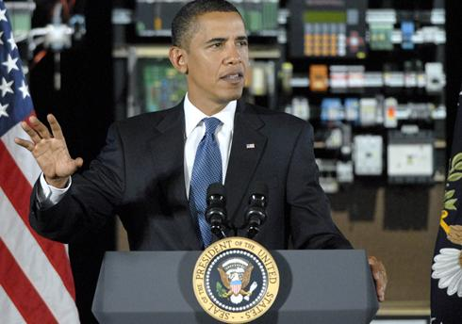
SPEECH PRODUCTION,RECOGNITION, ANALYSIS, AND SYNTHESIS
MUSICAL ACOUSTICS
Science of Sound, Chapters15, 16
The Speech Chain, Chapter 4

Slide 2
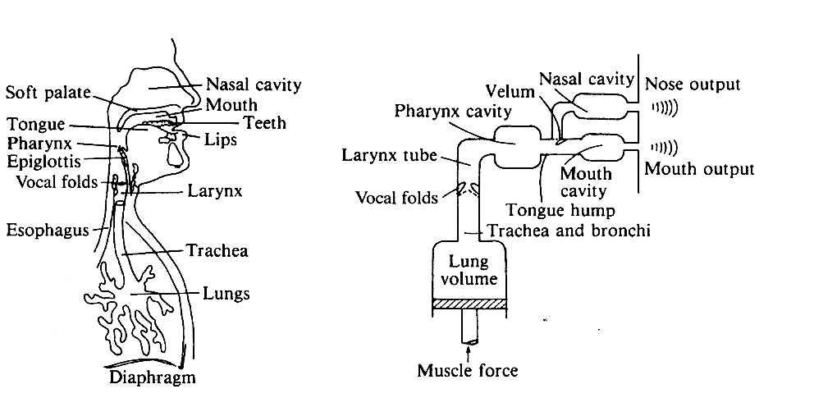
THE VOCAL ORGANS

Slide 3
VOCAL TRACT WITH SOFT PALATE LOWERED FOR BREATHING
Vocal folds (glottis)

Slide 4
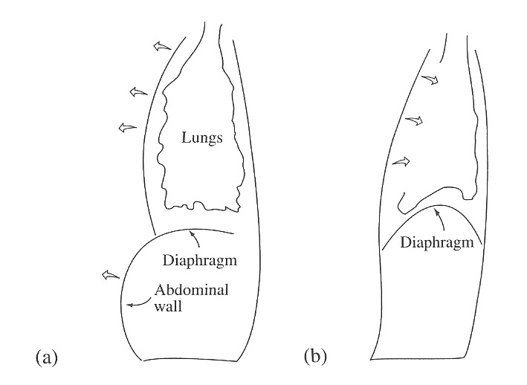
BREATHING AND AIR FLOW
Lungs have no muscles; Breathing is accomplished by changing the size of the chest cavity in two ways:
Downward movement of the diaphragm to lengthen the chest cavity;
2. Elevation of the ribs to
increase the front-to-back
thickness
Two muscle groups are used:
EXTERNAL and INTERNAL INTERCOSTALS that expand and contract the rib cage;
2. ABDOMINAL WALL and DIAPHRAGM which change the abdominal cavity

Slide 5
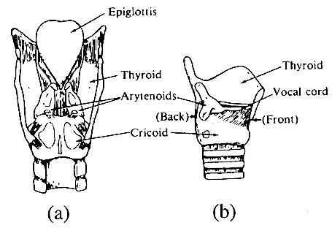
THE LARYNX
BACK VIEW
(b) SIDE VIEW

Slide 6
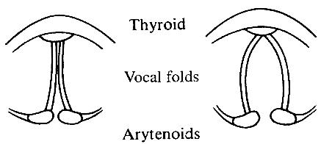
VOCAL FOLDS
CONTROL OF THE GLOTTAL OPENING BY THE ARYTENOIDS

Slide 7
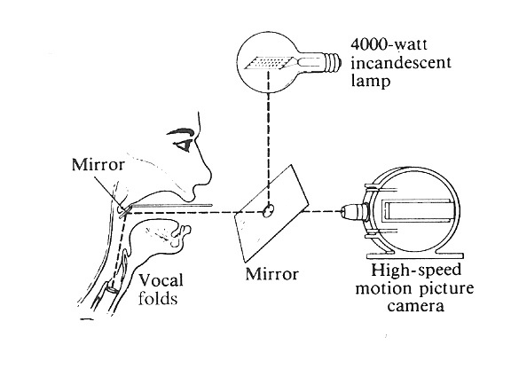
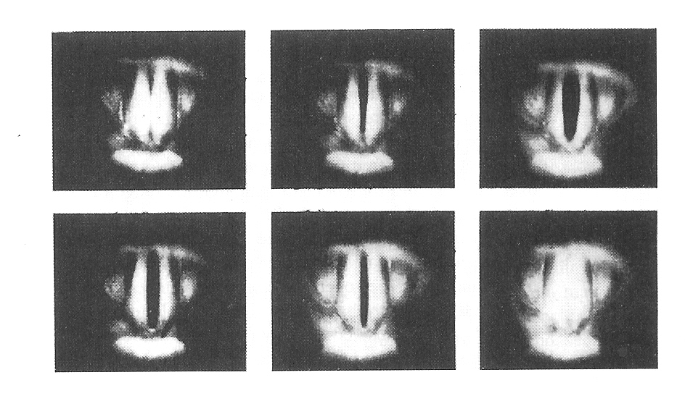
VOCAL FOLD VIBRATIONS

Slide 8
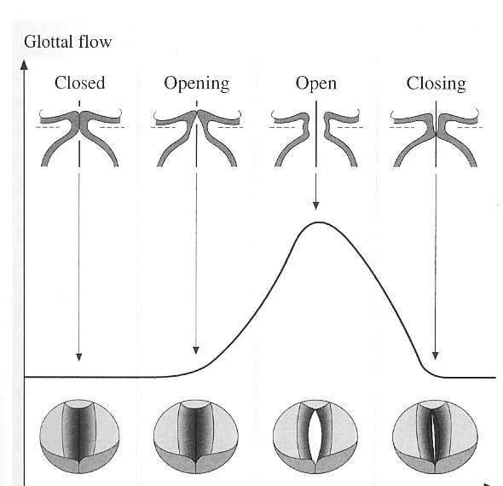
GLOTTOGRAMS (GLOTTAL FLOW WAVEFORMS)
SHOW HOW THE AIR FLOW THROUGH THE GLOTTIS VARIES WITH TIME

Slide 9
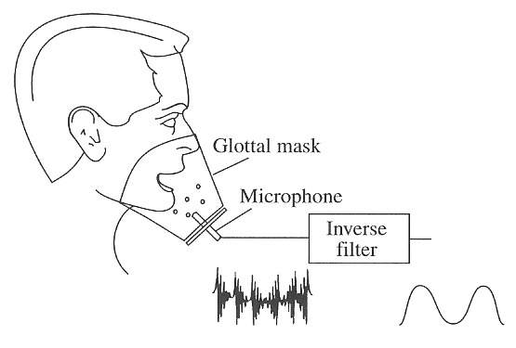
GLOTTAL MASK WITH INVERSE FILTERING
Subject phonates through an acoustic resistance, so that the microphone measures glottal flow
Inverse filter has a transfer function is the inverse of the vocal tract transfer function. Thus it minimizes the effect of the vocal tract and displays the glottal flow as if there were no vocal tract,

Slide 10
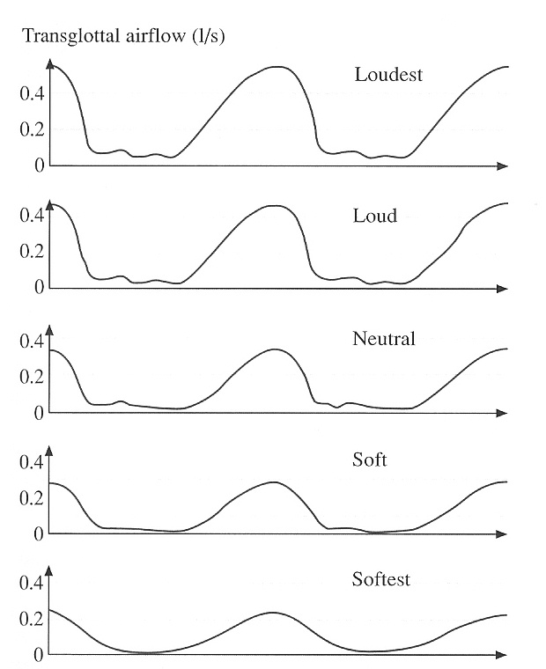
GLOTTOGRAMS FOR LOUD AND SOFT PHONATION
Loud phonation requires a rapid closure of the glottis

Slide 11
SOURCE/FILTER MODEL OF SPEECH
The source/filter model describes sounds of speech and singing as a product of source and filter radiation efficiency
SPEECH SOUND = SOURCE x FILTER x RADIATION EFFICIENCY
If each of these quantities is expressed decibels (dB), then the contributions are added rather than multiplied. .
The source function decreases in strength about 12 dB/octave. The radiation efficiency of the mouth rises about 6 dB/octave, so the net decrease due to the 1st and 3rd terms in the equation is about
6 dB/octave.

Slide 12
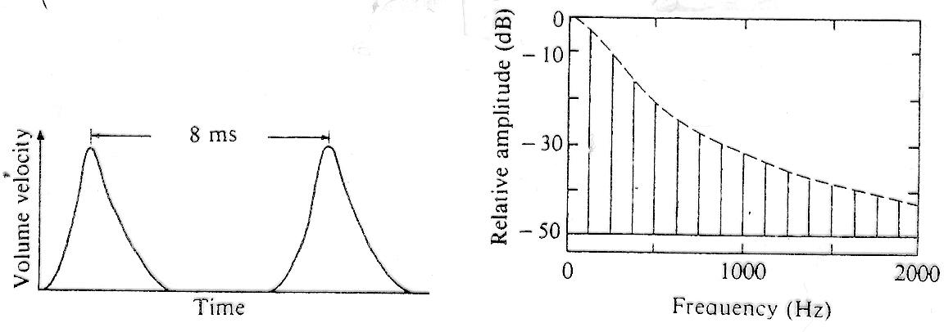
GLOTTAL WAVE FORM
SPECTRUM

Slide 13
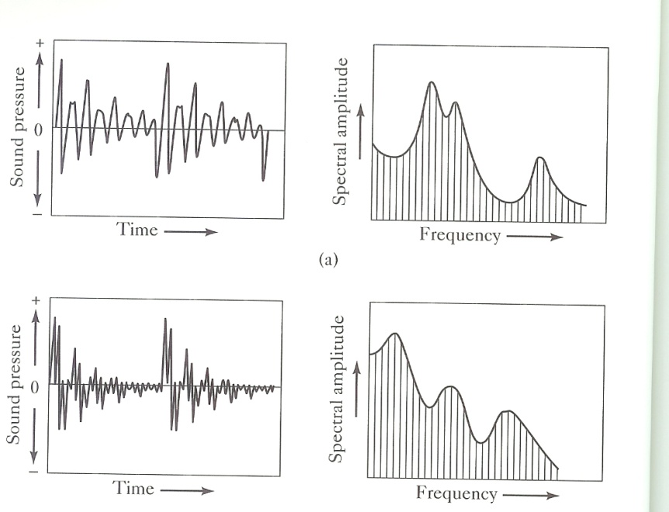
WAVEFORMS AND SPECTRA OF TWO VOWELS
/a/ (ah)
/u/ (uh)

Slide 14
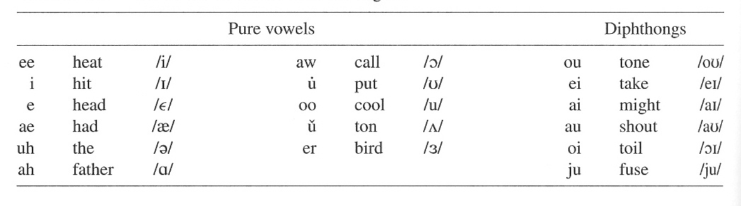
VOWELS OF AMERICAN ENGLISH

Slide 15
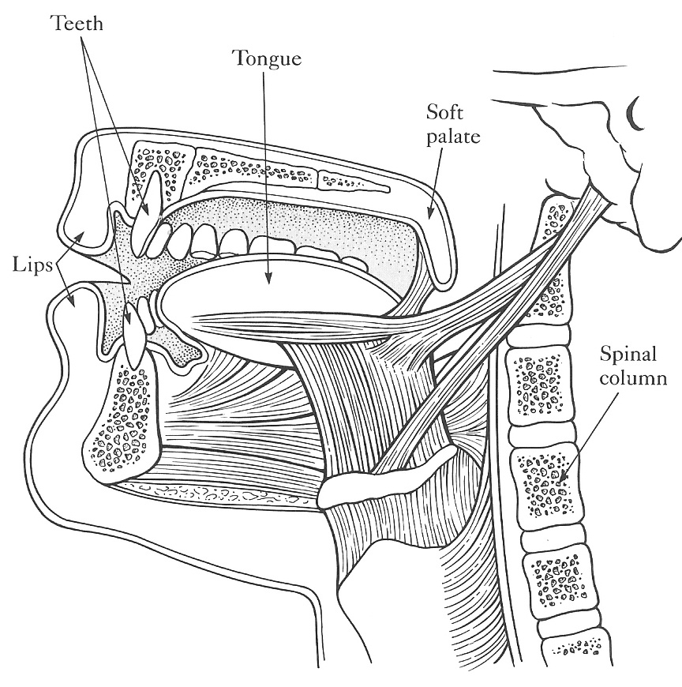
MUSCLES OF THE TONGUE

Slide 16
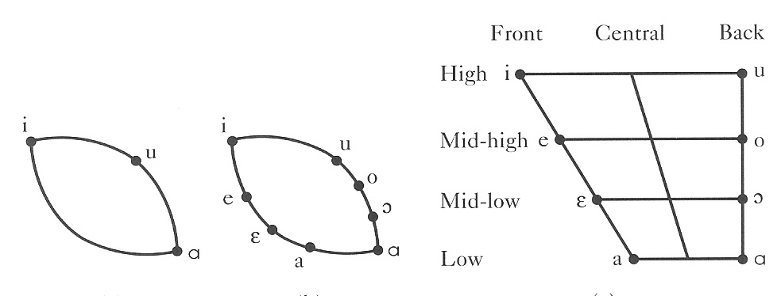
TONGUE POSITIONS FOR CARDINAL VOWELS

Slide 17
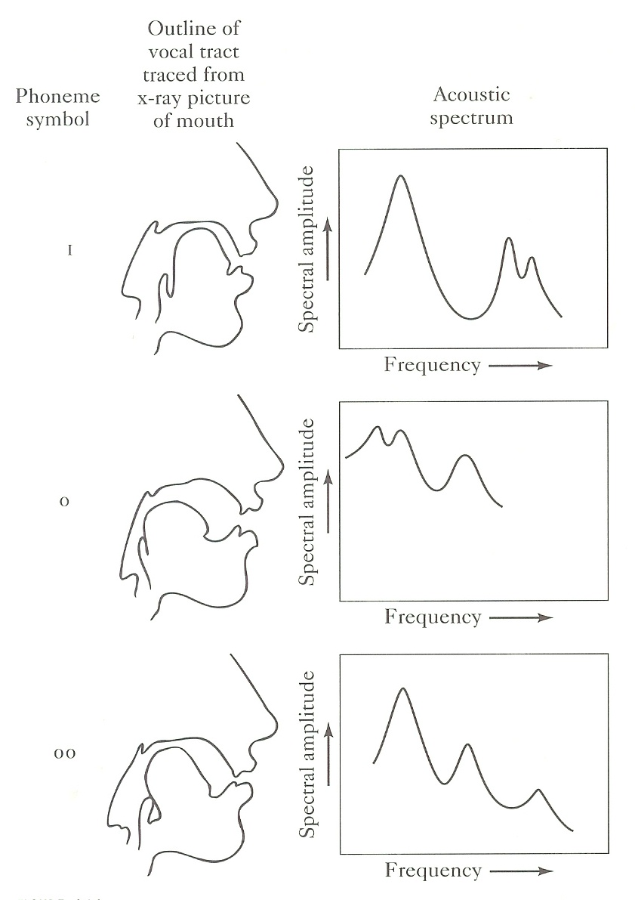
VOCAL TRACT CONFIGURATIONS FOR VOWELS i, o, oo

Slide 18
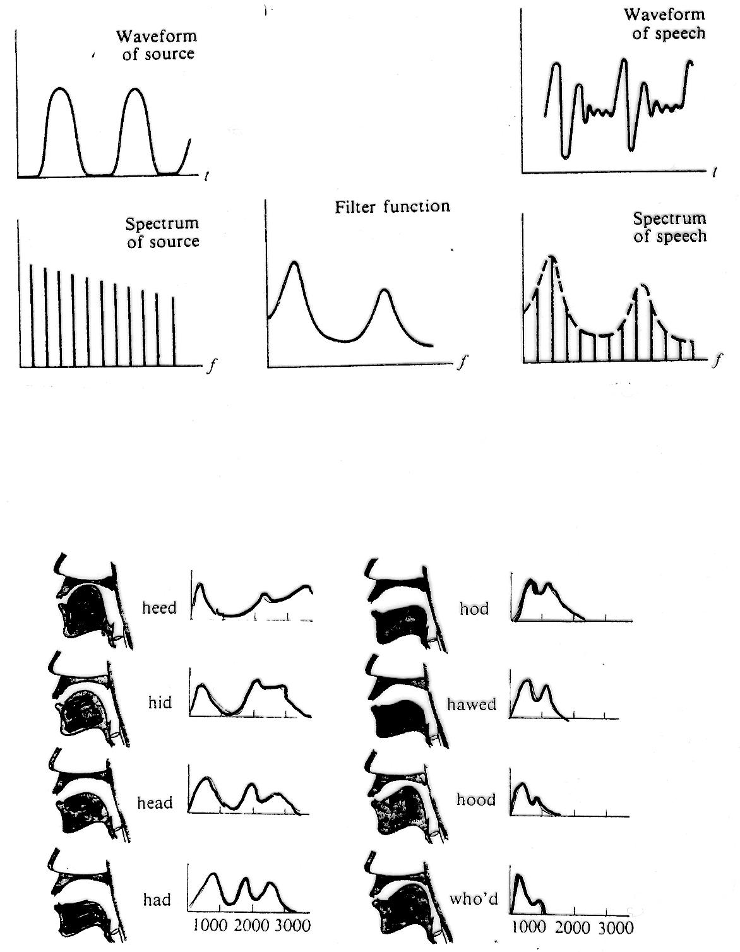
THE EFFECT OF FORMANTS ON SOUND

Slide 19
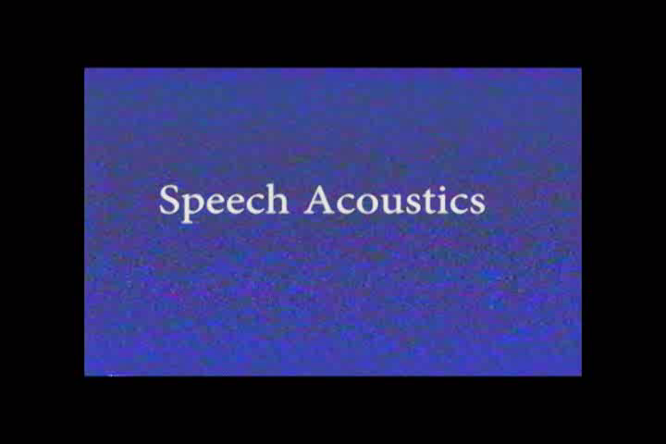

Slide 20
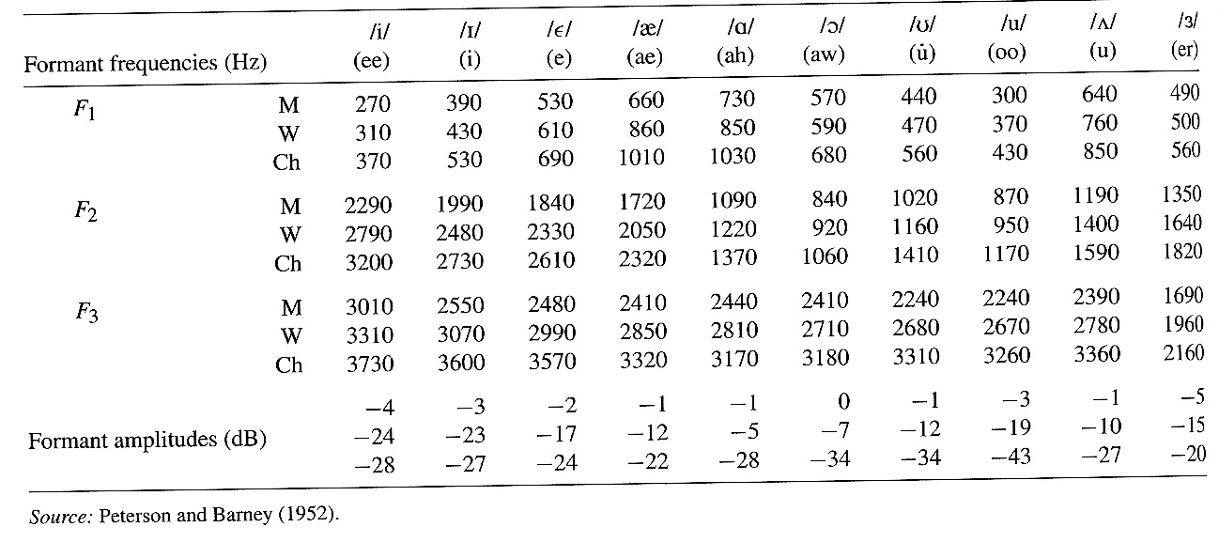
FORMANT FREQUENCIES AND AMPLITUDES
(AVERAGE OF 76 SPEAKERS)

Slide 21
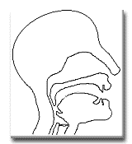
Voice Acoustics: an introduction Speech science has a long history. Speech and voice acoustics are an active area of research in many labs, including our own, which studies the singing and speaking voice. This document gives an introduction and overview. This is followed by a more detailed account, sometimes using experimental data to illustrate the main points. Throughout, a number of simple experiments are suggested to the reader.
Introduction and overview The source The filter Vowels Consonants Source-filter interactions Contrasting the voice with wind instruments The Source-Filter model Some difficulties The source at the larynx Different registers and vocal mechanisms Producing a sound When is the source independent of the filter? Resonances, spectral peaks, formants, phonemes and timbre Phonemes The vocal tract as a pipe or duct Resonances, frequency, pitch and hearing Timbre and singing The origin of vocal tract resonances Tract-wave interactions Do the ‘source’ and the ‘filter’ affect each other? Does the glottis affect the tract resonances? Do pressure waves affect the vocal fold vibration? Do singers and speakers use tract resonances and pitch in a coordinated way? Harmonic singing The singers formant References Links
Voice Acoustics: an introduction
Speech science has a long history. Speech and voice acoustics are an active area of research in many labs, including our own, which studies the singing and speaking voice. This document gives an introduction and overview. This is followed by a more detailed account, sometimes using experimental data to illustrate the main points. Throughout, a number of simple experiments are suggested to the reader.
THE WEBSITE http://www.phys.unsw.edu.au/jw/voice.html IS HIGHLY RECOMMENDED. PROFS. WOLFE AND SMITH AT THE UNIVERSITY OF NEW SOUTH WALES IN AUSTRALIA TEACH A COURSE SIMILAR TO THIS ONE.

Slide 22
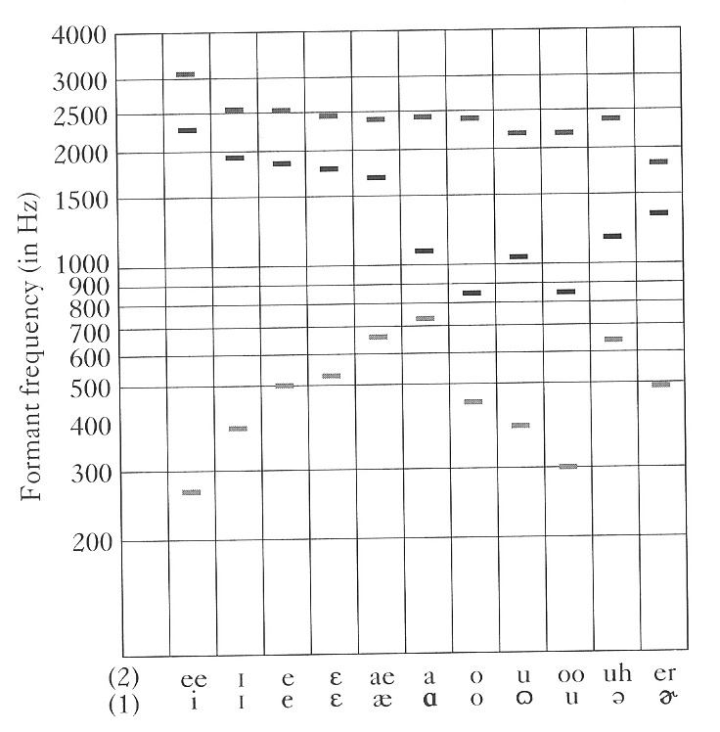
VOWEL FORMANT FREQUENCIES

Slide 23
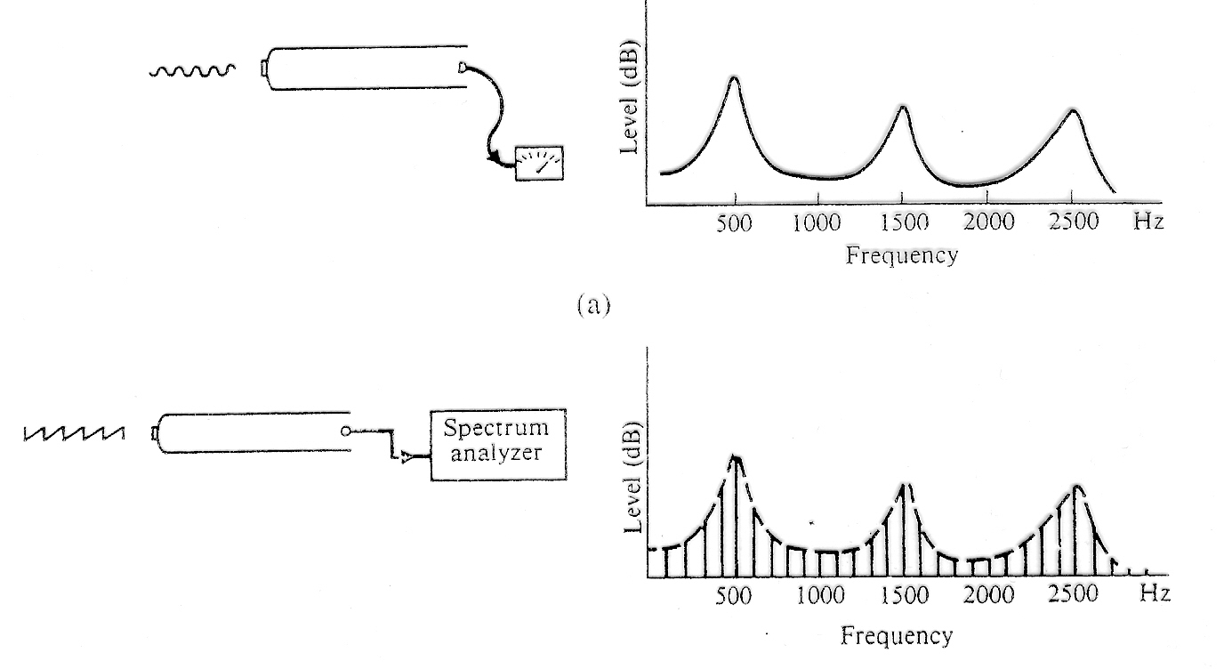
CLOSED PIPE MODEL OFTHE VOCAL TRACT

Slide 24
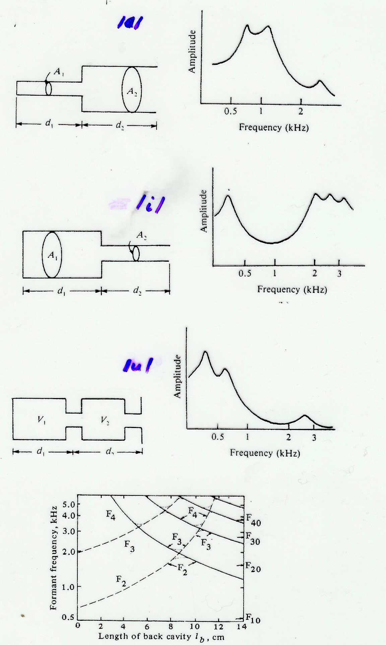
SIMPLE MODELS OF THE VOCAL TRACT FOR VOWEL SOUNDS

Slide 25
CONSONANTS
Consonants involve very rapid, sometimes subtle changes in sound . Consonants are more difficult to analyze and to describe acoustically .
Consonants may be classified according to the manner of articulation as plosive, fricative, nasal, liquid, and semivowel.
PLOSIVE consonants (p, b, t, etc.) are produced by blocking the flow of air (usually in the mouth) and releasing the pressure rather suddenly.
FRICATIVES (f, s, sh, etc.) are made by constricting the flow to produce turbulence.

Slide 26
CONSONANTS
Consonants involve very rapid, sometimes subtle changes in sound . Consonants are more difficult to analyze and to describe acoustically .
Consonants may be classified according to the manner of articulation as plosive, fricative, nasal, liquid, and semivowel.
PLOSIVE consonants (p, b, t, etc.) are produced by blocking the flow of air (usually in the mouth) and releasing the pressure rather suddenly.
FRICATIVES (f, s, sh, etc.) are made by constricting the flow to produce turbulence.
NASALS (m, n, ng) are made by lowering the soft palate to connect the nasal cavity to the pharynx and blocking the mouth cavity somewhere.
SEMIVOWELS (w, y) are produced by keeping the vocal tract briefly in a vowel position and then changing it rapidly to the vowel sound that follows.
To sound the LIQUIDS, (r,l), the tip of the tongue is raised and the oral cavity is somewhat restricted.

Slide 27
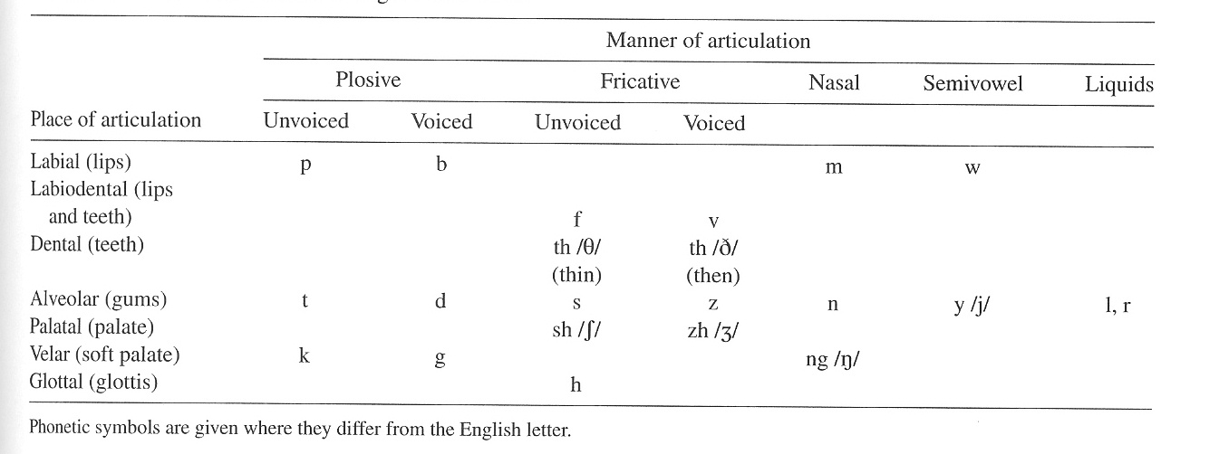

Slide 28
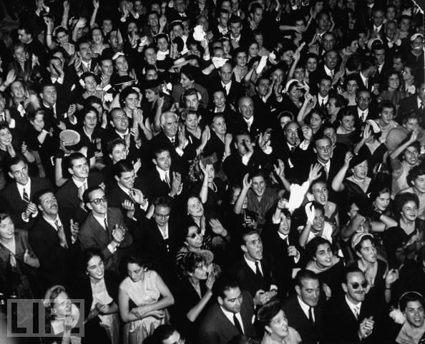

SPEECH RECOGNITION
Our ability to recognize the sounds of language is truly phenomenal. We can recognize more than 30 phonemes per second.
Speech can be understood at rates as high as 400 words per minute.

Slide 29
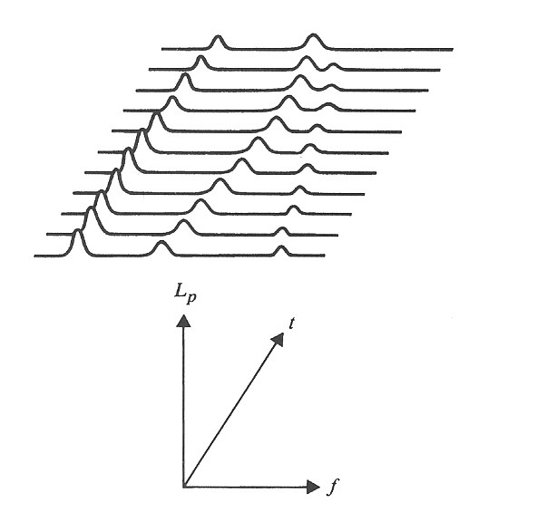
ANALYSIS OF SPEECH
THREE-DIMENSIONAL DISPLAY OF
SOUND LEVEL VERSUS FREQUENCY AND TIME

Slide 30
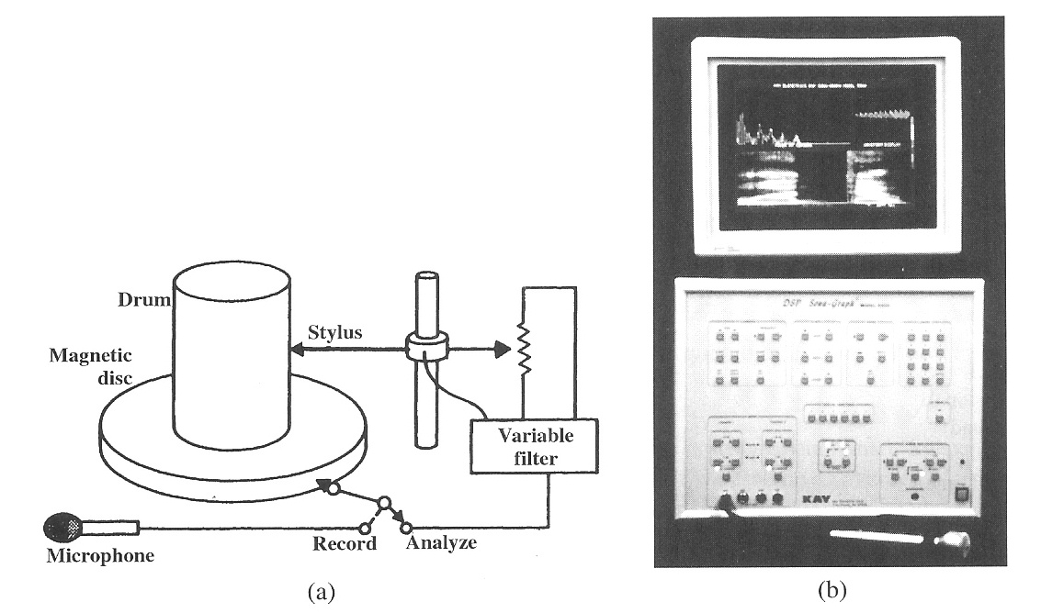
SPEECH SPECTROGRAPH
AS DEVELOPED AT BELL LABORATORIES (1945)
DIGITAL VERSION

Slide 31
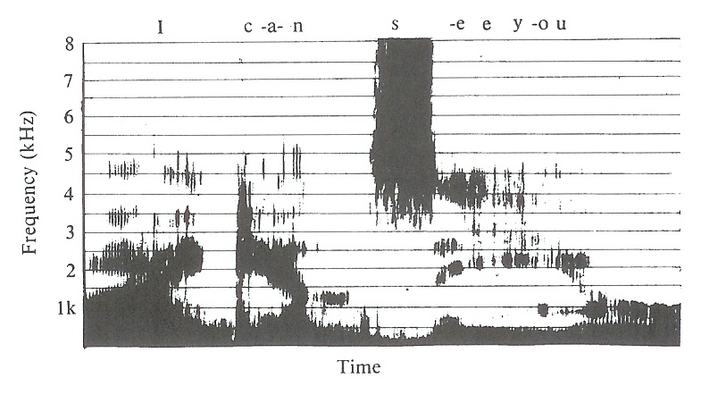
SPEECH SPECTROGRAM

Slide 32
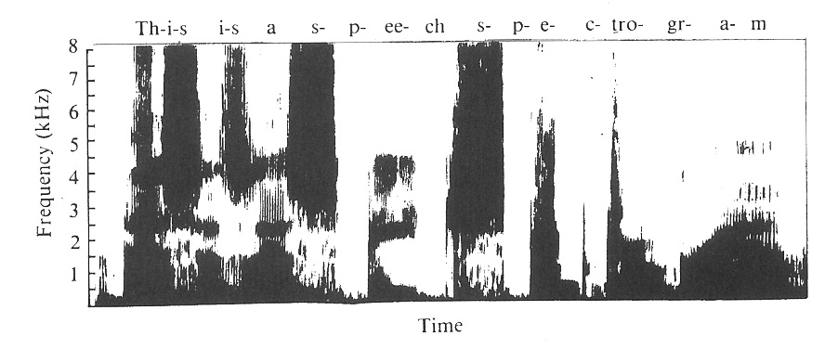
SPEECH SPECTROGRAM OF A SENTENCE:
This is a speech spectrogram

Slide 33
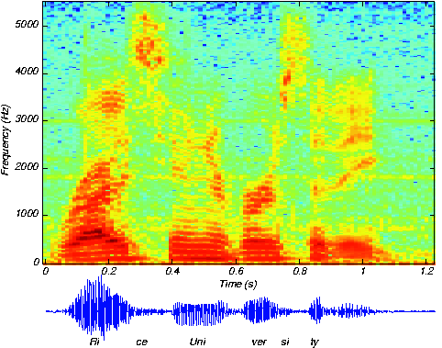
SPEECH SPECTROGRAM WITH COLOR
Adding color adds additional information

Slide 34
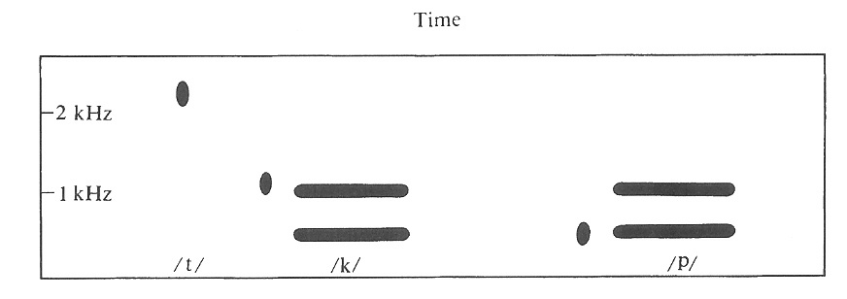
PATTERN PLAYBACK MACHINE
Consonant sounds change very rapidly, are difficult to analyze.
The sound cues, by which they are recognized, often occur in the first few milliseconds.
Much early knowledge about the recognition of consonants resulted from the pattern playback machine, developed at the Haskins Laboratry, which works like a speech spectrograph in reverse
Patterns may be printed on plastic belts in order to study the effects of varying the features of speech one by one.
A dot produces a “pop” like a plosive consonant.
STIMULUS PATTERN FOR PRODUCING /t/, /k/, AND /p/ SOUNDS

Slide 35
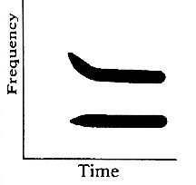
TRANSITIONS MAY OCCUR IN EITHER THE FIRST OR SECOND FORMANT
A FORMANT TRANSITION WHICH MAY PRODUCE /t/, /p/, OR /k/ DEPENDING ON THE VOWEL WHICH FOLLOWS

Slide 36
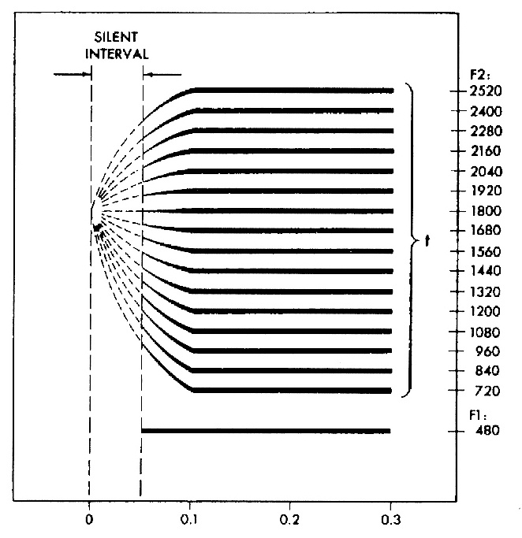
TRANSITIONS THAT APPEAR TO ORIGINATE FROM 1800 Hz
SECOND-FORMANT TRANSITIONS PERCEIVED AS THE SAME PLOSIVE CONSONANT /t/ (after Delattre, Liberman, and Cooper, 1955)

Slide 37
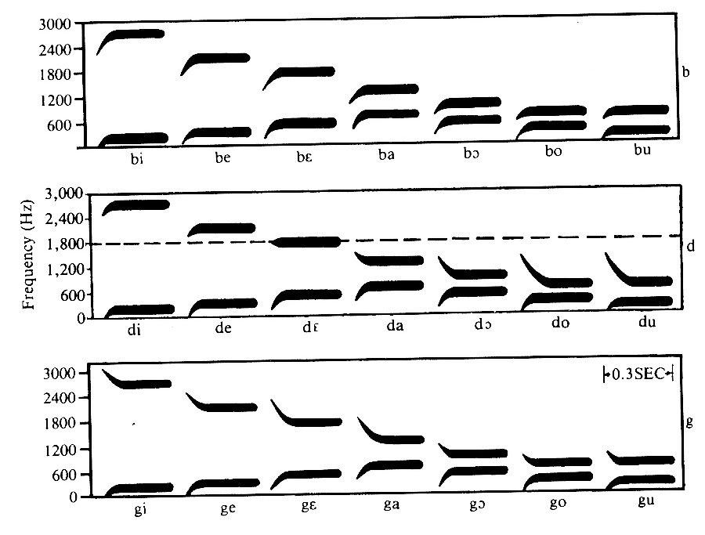
PATTERNS FOR SYNTHESIS OF /b/, /d/, /g/
PATTERNS FOR THE SYNTHESIS OF /b/, /d/, AND /g/ BEFORE VOWELS
(THE DASHED LINE SHOWS THE LOCUS FOR /d/)

Slide 38
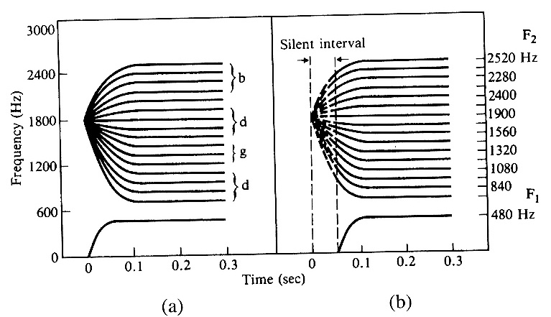
PATTERNS FOR SYNTHESIZING /d/
(a) SECOND FORMANT TRANSITIONS THAT START AT THE /d/-LOCUS
(b) COMPARABLE TRANSITIONS THAT MERELY “POINT” AT THE /d/-LOCUS
TRANSITIONS IN (a) PRODUCE SYLLABLES BEGINNING WITH /b/, /d/, OR /g/ DEPENDING ON THE FREQUENCY LEVEL OF THE FORMANT;
THOSE IN (b) PRODUCE ONLY SYLLABLES BEGINNING WITH /d/

Slide 39
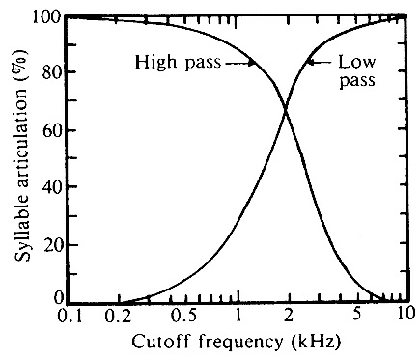
FILTERED SPEECH
Filters may have high-pass, low-pass, band-pass, or band-reject characteristics.
Speech intelligibility is usually measured by articulation tests in which a set of words is spoken, and listeners are asked to identify them.
Articulations scores for speech filtered with high-pass and low-pass filters. The curves cross over at 1800 Hz where the articulation scores for both are 67%. Normal speech is intelligible with both types of filters, although the quality is changed.

Slide 40
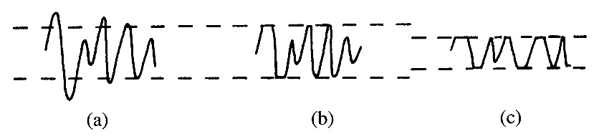
WAVEFORM DISTORTION
Peak clipping is a type of distortion that results from overdriving an audio amplifier. It is sometimes used deliberately to reduce bandwidth.
ORIGINAL SPEECH MODERATE CLIPPING SEVERE CLIPPING
Even after severe clipping in (c), the intelligibility remains 50-90% depending on the listener

Slide 41
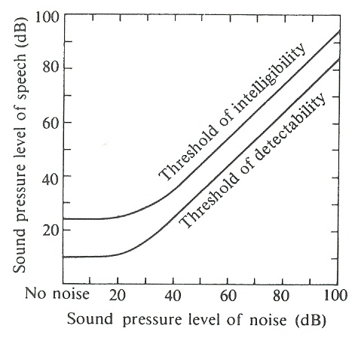
EFFECT OF NOISE ON SPEECH INTELLIGIBILITY
The thresholds of intelligibility an detectability as functions of noise level

Slide 42
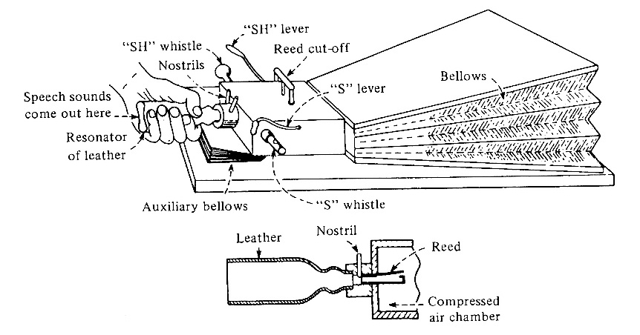
SYNTHESIS OF SPEECH
An early attempt (1791) to synthesize speech was von Kempelen’s “talking machine.” A bellow supplies air to a reed, which serves as the voice source.
A leather “vocal tract is shaped by the fingers of one hand.
Consonants are simulated by four constricted passages ;controlled by the fingers of the other hand..
Wheatstone’s reconstruction of von Kempelen’s talking machine

Slide 43
SPEECH SYNTHESIS
ACOUSTIC SYNTHESIZERS—MECHANICAL DEVICES BY VON KEMPELEN, WHEATSTONE, KRATZENSTEIN, VON HELMHOLTZ, etc.
CHANNEL VOCODERS (voice coders)---CHANGES IN INTENSITY IN NARROW BANDS ARE TRANSMITTED AND USED TO REGENERATE SPEECH SPECTRA IN THESE BANDS.
FORMANT SYNTHESIZERS---USES A BUZZ GENERATOR (FOR VOICED SOUNDS) AND A HISS GENERATOR (FOR UNVOICED SOUNDS) ALONG WITH A SERIES OF ELECTRICAL RESONATORS (TO SIMULATE FORMANTS).
LINEAR PREDICTIVE CODING (LPC)---TEN OR TWELVE COEFFICIENTS ARE CALCULATED FROM SHORT SEGMENTS OF SPEECH AND USED TO PREDICT NEW SPEECH SAMPLES USING A DIGITAL COMPUTER
HMM-BASED SYNTHESIS OR STATISTICAL PARAMETRIC SYNTHESIS---BASED ON HIDDEN MARKOV MODELS. USES MAXIMUM LIKELIHOOD TO COMPUTE WAVEFORMS

Slide 44
SPEECH RECOGNITION
As early as 1932, Bell Labs researchers such as Harvey Fletcher were investigating the science of speech perception.
Unfortunately, funding at Bell Labs dried up for several years when the influential John Pierce wrote an open letter comparing speech recognition to “schemes for turning water into gasoline, extracting gold from the sea, curing cancer, or going to the moon.”
During the late 1960s, Leonard Baum developed the mathematics of Markov chains for the Institute for Defense Analysis.
IBM developed a voice activated typewriter by the mid 1980s.
(https://wikipeddia.org/wiki/Speech_recognition)

Slide 45
AUTOMATIC SPEECH RECOGNITION BY COMPUTER
Automatic speech recognition is the “holy grail” of computer speech research.
Human listeners have learned to understand different dialects, accents, voice inflections, and even synthesized speech of rather low quality. It is still difficult for computers to do this.
A common strategy for recognizing individual words is template matching. Templates are created for the words in the desired vocabulary as spoken by selected speakers. Spoken words are then matched to these templates, and the closest match is assumed to be the word spoken. Matching is often done with Hidden Markov Models.
Continuous speech recognition is much more difficult than individual words because it is difficult to recognize the beginning and end of words, syllables and phonemes.

Slide 46
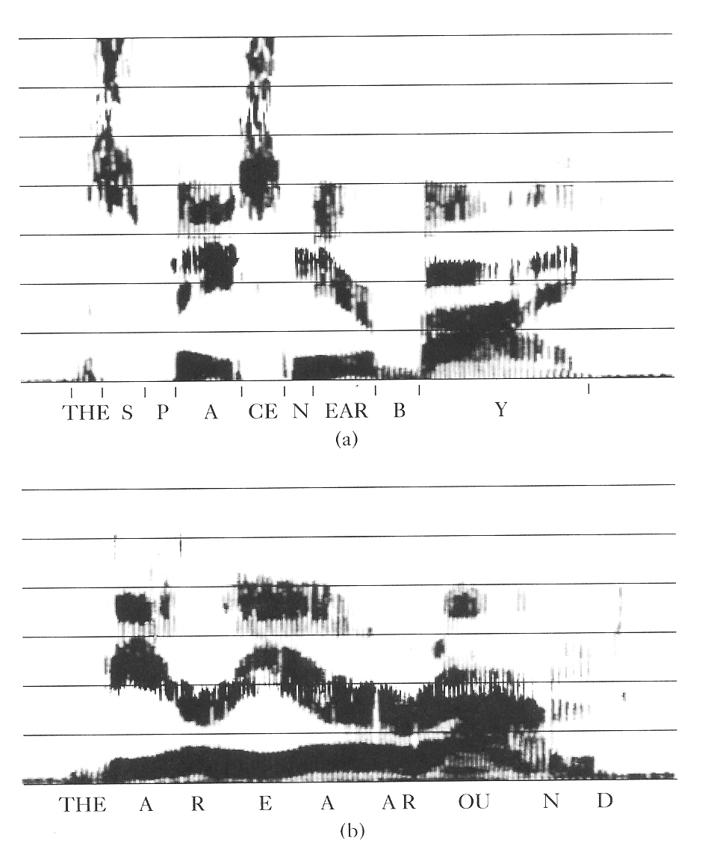
RECOGNIZING WORD BOUNDARIES
“THE SPACE NEARBY”
Word boundaries can be located by the initial or final consonants.
“THE AREA AROUND”
Word boundaries are difficult to locate

Slide 47
SIRI
Apple is said to have partnered with Nuance Communications to develop a powerful speech recognition program for the Apple iPhone 5 and iPad. When you speak, your words are captured, digitized, compressed and sent to the Cloud for processing. Questions asked of “Siri” are quickly answered.
Microsoft has a family of speech recognition apps based on its Speech API. Windows speech recognition is available for Windows 7, 8, and 10.

Slide 48
SPEAKER IDENTIFICATION: VOICEPRINTS
Speech spectrograms portray short-term variations in intensity and frequency in graphical form. Thus they give much useful information about speech articulation.
When two persons speak the same word, their articulation is similar but not identical. Thus spectrograms of their speech will show similarities but also differences.

Slide 49
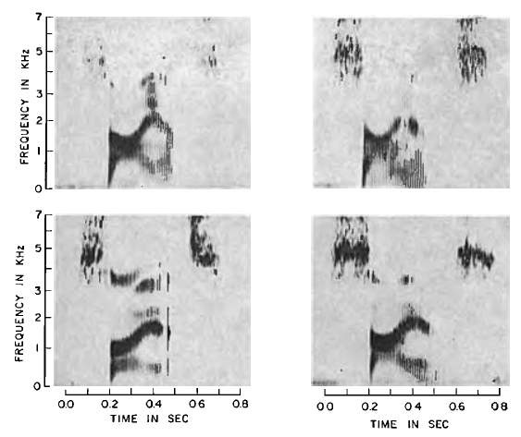
SPECTROGRAMS OF THE SPOKEN WORD “SCIENCE.” WHICH TWO SPECTROGRAMS WERE MADE BY THE SAME SPEAKER?

Slide 50
THE TWO SPECTROGRAMS AT THE TOP WERE MADE BY THE SAME SPEAKER.
THE TWO SPECTROGRAMS AT THE BOTTOM WERE MADE BY TWO OTHER SPEAKERS

Slide 51
PROSODY
IN LINGUISTICS, PROSODY IS THE RHYTHM, STRESS, AND INTONATION OF SPEECH. PROSODY MAY REFLECT VARIOUS FEATURES OF THE SPEAKER OR THE UTTERANCE, THE EMOTIONAL STATE OF A SPEAKER, WHETHER THE UTTERANCE IS A STEMENT, A QUESTION, OR A COMMAND; WHETHER THE SPEAKER IS BEING IRONIC OR SARCASTIC; EMPHASIS, CONTRAST AND FOCUS.
IN TERMS OF ACOUSTICS, THE PROSODICS OF ORAL LANGUAGES INVOLVE VARIATION IN SYLLABLE LENGTH, LOUDNESS, PITCH, AND THE FORMANT FREQUENCIES OF SPEECH SOUNDS.
PROSODY IS OF GREAT INTEREST IN AUTOMATIC SPEECH RECOGNITION

Slide 52
DECLARATIVE, INTEROGATIVE, IMPERATIVE
DECLARATIVE: “You are going home”
INTEROGATIVE: “You are going home?” (voice is raised at end of sentence)
IMPERATIVE: “You ARE going home!” (are is emphasized)

Slide 53
EMOTIONAL STATE OF THE SPEAKER
PROSODIC FEATURES TEND TO INDICATE THE EMOTIONAL STATE OF THE SPEAKER.
“RAISING ONE’S VOICE “ IN ANGER, FOR EXAMPLE, INCREASES BOTH LOUDNESS AND PITCH.
A STATE OF EXCITEMENT FREQUENCY CAUSES AN INCREASE IN THE RATE OF SPEAKING. ATTEMPTS HAVE BEEN MADE TO ACCOMPLISH ACOUSTIC “LIE DETECTION” BY ANALYZING THE PROSODIC FEATURES OF RECORDED SPEECH FOR EVIDENCE OF STRESS

Slide 54
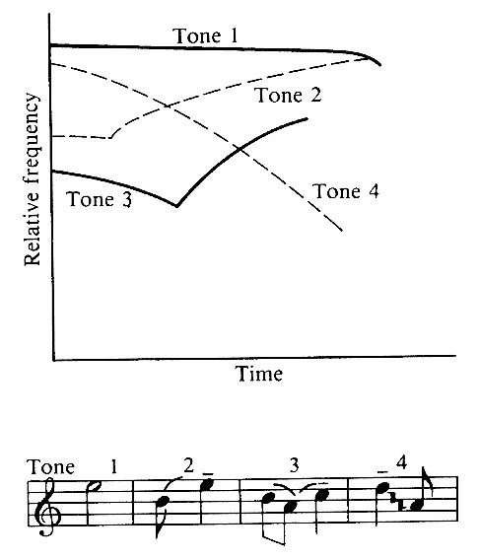
TONE
In some languages, such as Chinese, a phoneme can take on different meanings depending on its tone.
The four tones in Mandarin Chinese are shown.

Slide 55
ACCENTS
“TWO COUNTRIES SEPARATED BY A COMMON LANGUAGE”
Have you ever misunderstood someone or been misunderstood by someone who speaks with a different accent? The sounds that an American hears as 'Bob the clerk' may be heard by an Australian as 'barb the clock'.

Slide 56
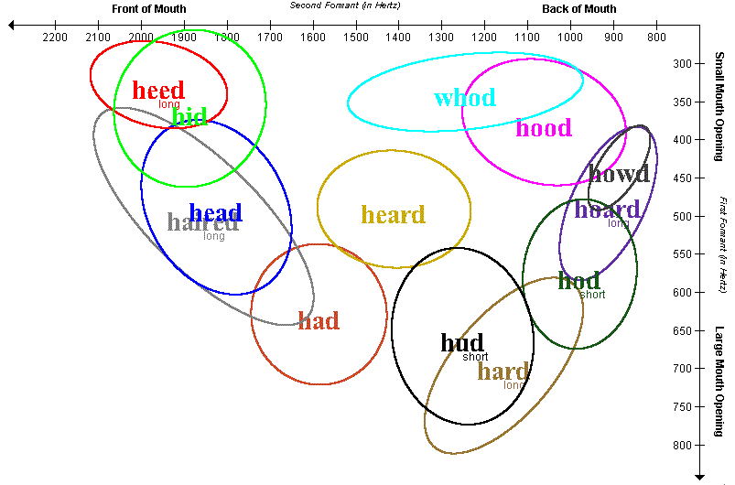
The two most important parameters in determining different vowel sounds are the first two formants, which are frequency bands with increased power. These are the two axes on the graph. The axes are traditionally plotted backwards, as here, so that they approximately correspond to the axes long used by phoneticians and linguists: F1 (vertical) approximately corresponds to the jaw height (which correlates negatively with the extent of the mouth opening). F2 (horizontal) approximately corresponds to the position (forward or back) of the constriction of the vocal tract where the tongue is close to the roof of the mouth. Other important parameters are the length of the vowel and other formants

Slide 57
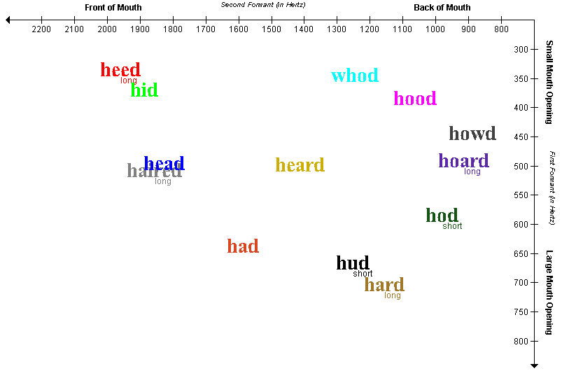
F1 AND F2 FOR ENGLISH VOWEL SOUNDS SPOKEN BY AUSTRALIAN SPEAKERS
F1 CORRELATES WITH MOUTH OPENING; F2 CORRELATES WITH TONGUE PLACEMENT

Slide 58
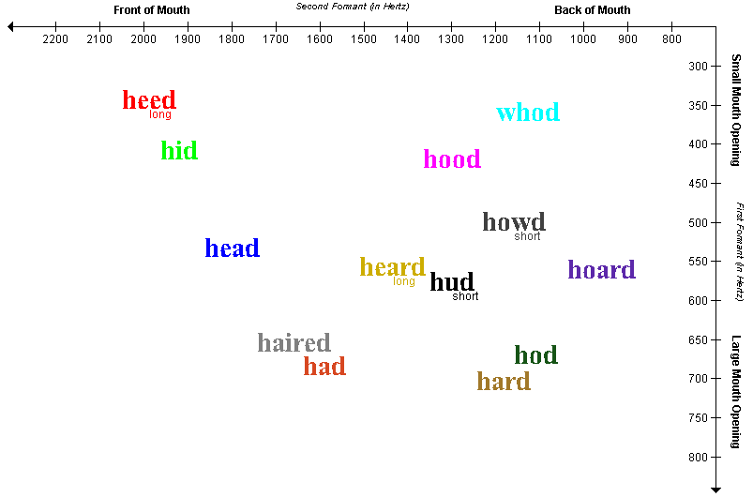
AUSTRALIAN SPEAKER
For the Australians in this sample, the words "hud" and "hard" have a similar sound, the main difference is the length. For this sample of Americans, it is "hud" and "heard" that are distinguished by length. For an Australian, a long bud is a bard, for an American, it's a bird.
AMERICAN SPEAKER

Slide 59
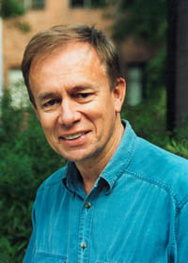
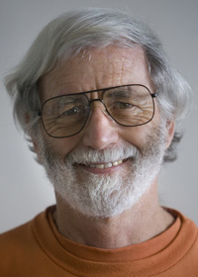
TO PARTICIPATE IN THIS SURVEY BY WOLFE, SMITH AND COLLEAGUES, CLICK ON http://project.phys.unsw.edu.au/swe/survey/form.php

Slide 60
Assignment for Monday:
Exercises in Chapter 15: 1, 2, 4, 5, 6, 7 (p.353-4)
Read Chapter 17

